Slide 1
CREDIT RISK ASSESSMENT
& Classification System
Leveraging Ensemble Machine Learning for Banking Decision Support
Presented by: Reuna Remon Supervised by: Prof. Ahmed Abdellah
1 / 10

Slide 2
Problem Statement & Motivation
1
2
3
The Context
The Problem
The Mission
Credit risk assessment is the backbone of banking security and financial stability.
Traditional manual review is subjective, slow, and prone to human error.
Build an automated, data-driven AI pipeline that predicts loan default risk with high precision.
Objective: Automate the decision-making process to improve accuracy, speed, and fairness in loan approvals.
2 / 10

Slide 3
Project Engineering Roadmap
A structured, three-phase engineering process ensures model reliability
PHASE 1
PHASE 2
PHASE 3
Data Engineering
Model Development
Evaluation & Optimization
Acquisition, cleaning, encoding & normalization of raw financial records.
→
Training multiple algorithms and tuning an ensemble architecture.
→
Stress-testing models and validating results beyond accuracy alone.
Speaker note: “We followed a structured, engineering-driven methodology to guarantee the accuracy and reliability of our final model.”
3 / 10

Slide 4
Phase 1: Data Engineering
Dataset: credit_risk_dataset.csv — 32,581 loan applicant records
1
Data Cleaning
Removed unrealistic outliers (age 100+, employment length 80+ years); median imputation on employment length & interest rate.
2
Feature Engineering
One-hot encoding (pandas get_dummies) to convert categorical fields into model-ready inputs.
3
Normalization
StandardScaler applied so all numerical features contribute equally to the model logic.
4
Split Strategy
31,679 records after cleaning, split into 25,343 for Training (80%) and 6,336 for Testing (20%) — so the model is judged only on data it has never seen.
“We used StandardScaler to rescale features so no single variable dominates the model.”
4 / 10

Slide 5
Phase 2: Model Architecture
A comparative study across four model families
Logistic Regression
K-Nearest Neighbors (k=5)
Linear baseline model, trained on scaled features.
Instance-based classification on scaled features.
Random Forest & XGBoost
ANN (MLPClassifier)
Ensemble learning — captures complex, non-linear relationships in the data.
Neural network with one hidden layer (100 units) for deep pattern recognition.
5 / 10

Slide 6
Experimental Results
Comparative accuracy across all trained models
KEY FINDING
93.1%
Peak accuracy — XGBoost (Random Forest close behind at 93.0%)
Ensemble methods (Random Forest, XGBoost) outperformed the linear baseline and KNN, making them the ideal choice for production deployment.
6 / 10

Slide 7
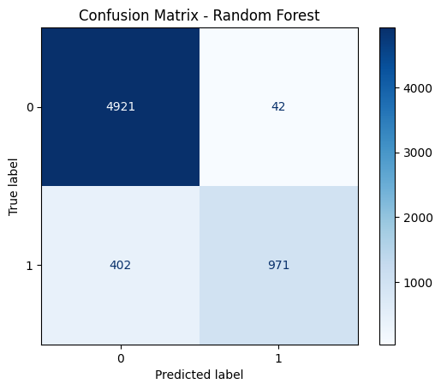
Performance Evaluation
Beyond accuracy: analyzing the Confusion Matrix (Random Forest)
Why accuracy alone isn’t enough
A high accuracy score can hide costly errors on the minority class.
The matrix reveals exactly where the model is confused — not just how often it's right.
In banking, a False Negative (approving a risky borrower) is far more costly than a False Positive.
Evaluated on the held-out test set (y_test) to confirm the model generalizes to unseen data.
5-Fold Cross-Validation confirmed stability: 92.66% average accuracy, ±0.78% standard deviation across folds.
7 / 10

Slide 8
Technical Challenges
Real obstacles encountered — and how we addressed them
!
△
⚖
Data Skewness
Overfitting
Class Imbalance
Challenge:
Challenge:
Challenge:
Financial data is naturally skewed (income distribution) with some extreme outlier values.
Complex models risk memorizing the training data instead of learning general patterns.
Risk of the model defaulting to the majority class.
Solution:
Solution:
Solution:
Removed unrealistic outliers and applied StandardScaler so extreme values don't dominate the model.
Relied on Random Forest's ensemble nature — averaging many independent trees naturally reduces any single tree's tendency to overfit.
Monitored per-class metrics via the Confusion Matrix, not accuracy alone.
8 / 10

Slide 9
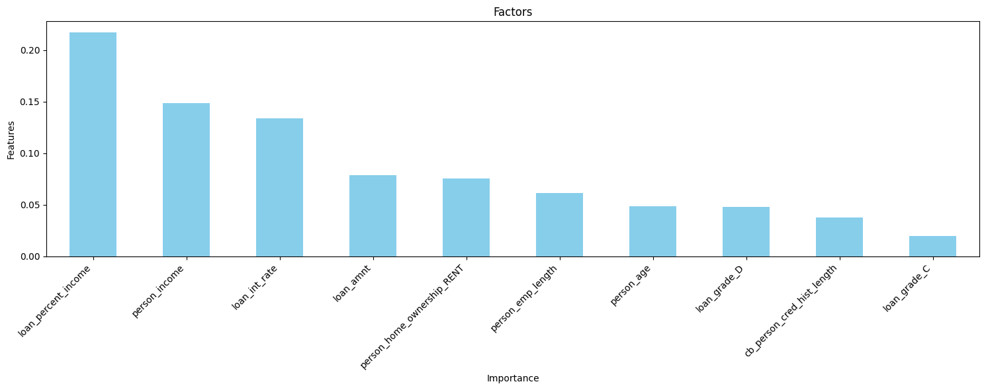
Key Insight: What Drives the Decision
Feature Importance extracted directly from the trained Random Forest model
TOP FACTOR
Loan-to-Income Ratio
The single strongest predictor of default risk in the model.
Business takeaway:
Banks can prioritize reviewing loan-to-income ratio, income, and interest rate first — these three factors drive most of the model's decision, more than applicant age or credit history length.
9 / 10

Slide 10
Conclusion & Impact
93.1%
Built an automated, end-to-end pipeline from raw data to a high-accuracy classifier.
Empowers banks with objective, data-driven loan decisions — reducing human bias.
Provides a scalable foundation for a modern, production-ready credit scoring system.
Peak model accuracy achieved with XGBoost (Random Forest: 93.0%)
“This system is not just a model — it's a scalable foundation for a modern, secure banking infrastructure.”
10 / 10

